Slide 1


Educational & entertraiment applications on Android platform
«Piano» and «Abetare»
14th Workshop “Software Engineering Education and Reverse Engineering”
Sinaia, Rumania, 24th - 30st August 2014
Anisa Shehu
Prof. Asoc. Elinda Meçe

Slide 2




Contents:
General knowledge on Android platform
How Software Engineering help me in projects
Development of environment
Development of “Piano” and “Abetare” applications in Android system
Testing of applications
Conclusions

Slide 3

Android platform
It’s a platform and an open-source operating system for mobile.
  It based in Linux kernel for the basic services of system :
      Security
      Memory management
      Process management
      Network Stack
      System’s drivers
  Library
      C/C++ libraries
      Interface through Java
      UI Windows
      Provide 2D and 3D graphic SGL
      Media codecs, SQLite, Browser engine

Slide 4
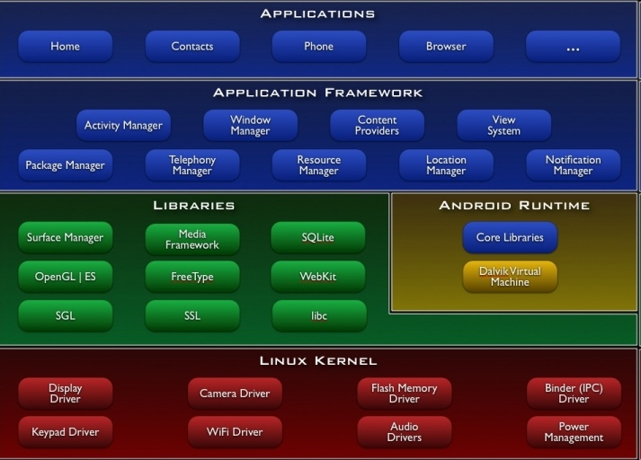
Architecture of Android OS
User
App Developers
Programmer
HW Developer

Slide 5

How SE help me in my project
Getting information
Preparing
Environment of
work
Testing
Implementations
of project
Requirement
Specifications
2-6 javë

Slide 6
Development of environment
Android SDK platform need to install two other software before , that aren’t part of platform:
  Java Development Kit (JDK 6 update 26)
  Eclipse Integrated Development Environment (IDE 3.6.1)
Installing packages through SDK manager
Installing plugin ADT (Android Development Tools ) http://developer.android.com/sdk/installing.html.

Slide 7
Android Application structure
Android Application (Piano/Abetare)
AndroidManifest.xml
(Registration of activities, services, icons,…,)
Intents
(Special class that helps windows to interact to each other)
Activities
(is a class that create
a UI windows)
Services
(are the code that can executed without UI)

Slide 8


Android application structure
The application is stored in .apk format
Recourse:
Data, sound files, images
java
code
aapt
java
code
Piano.apk
data
mp3
# library calls

Slide 9
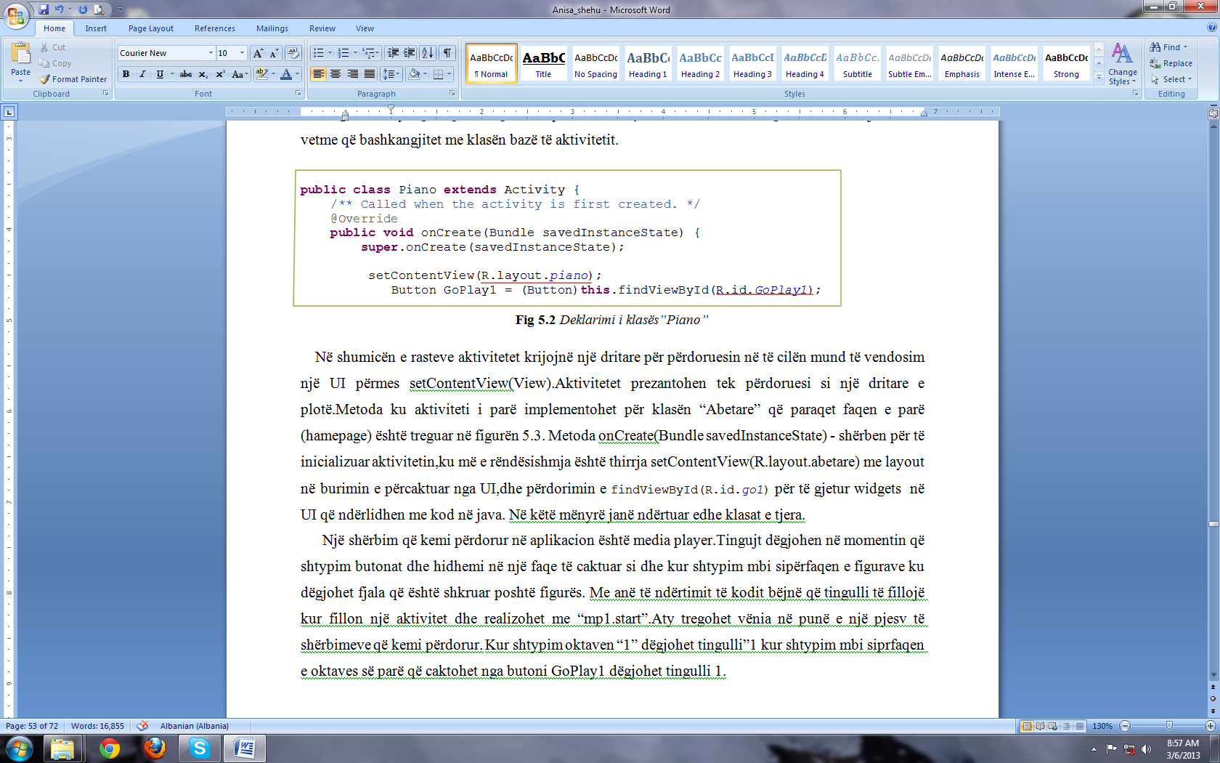
Java and XML code of Piano Class
<LinearLayout
android:id="@+id/linearLayout1"
android:layout_width="wrap_content"
android:layout_height="wrap_content"
android:layout_marginTop="43dip"
android:orientation="vertical"
android:minWidth="125dip">
<Button
android:id="@+id/GoPlay11"
android:layout_width="wrap_content"
android:layout_height="wrap_content"
android:text=""

Slide 10
Compiling the application
Android Application compile by bytecode Dalvik
Source code in Java
Compiled program from Java
ByteCode Dalvik
Linux OS
“upload” to Dalvik VM

Slide 11
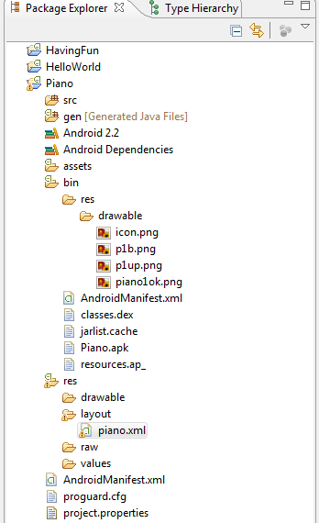
Application Structure from Eclipse:
code
Auto-generated resources
Files
images
UI layouts
Constants

Slide 12
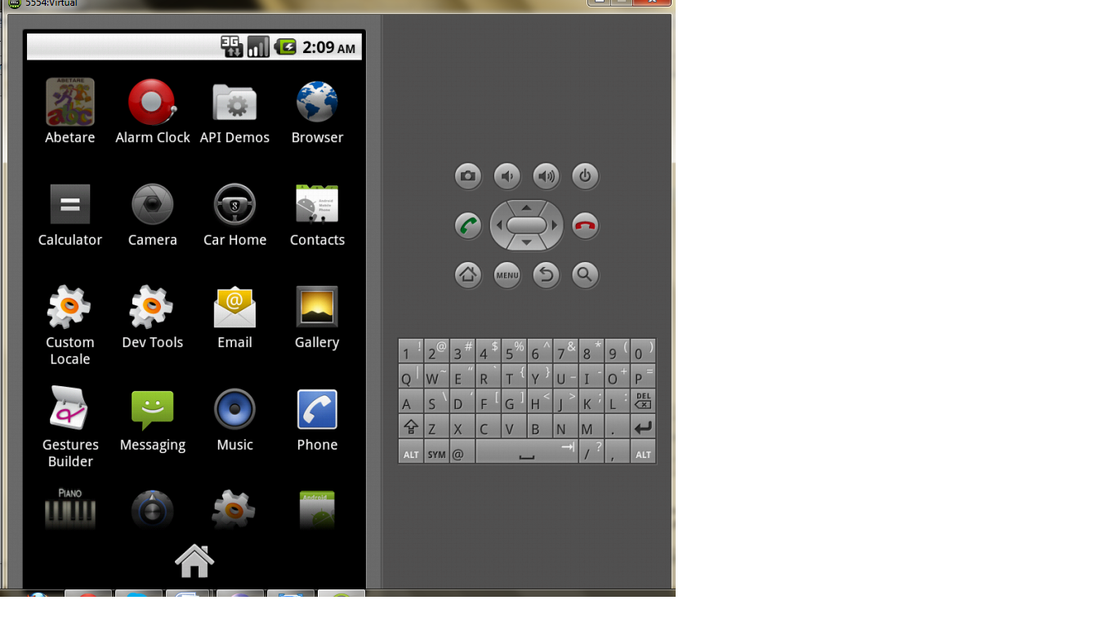
Piano Application icon DVM
Click over PIANO icon

Slide 13
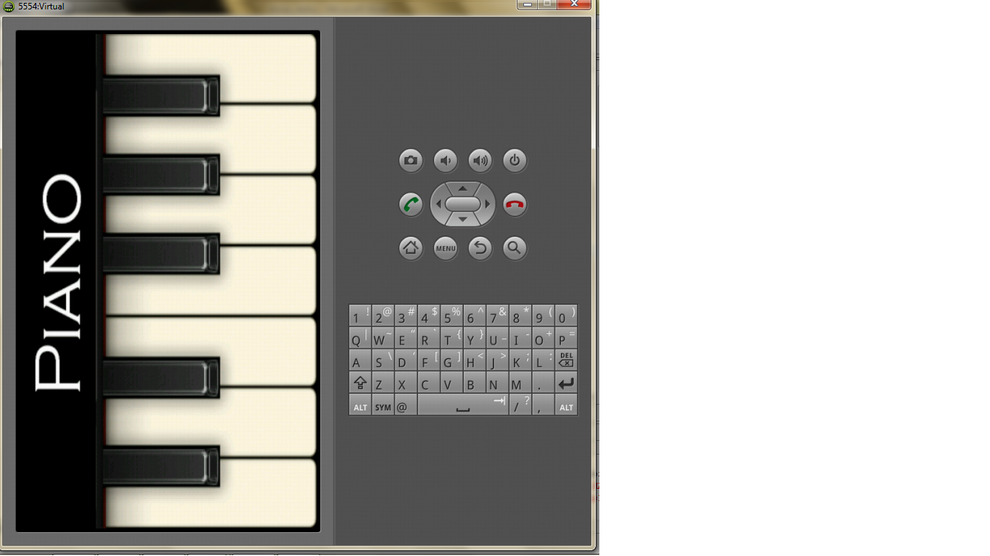
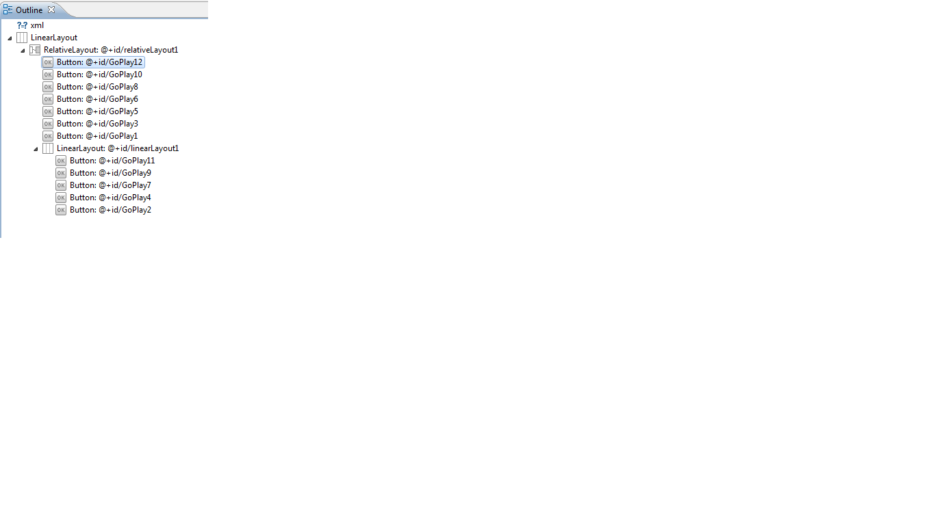
Outline of XLM button
Oktava “12”(major)
Oktava “11” minor

Slide 14
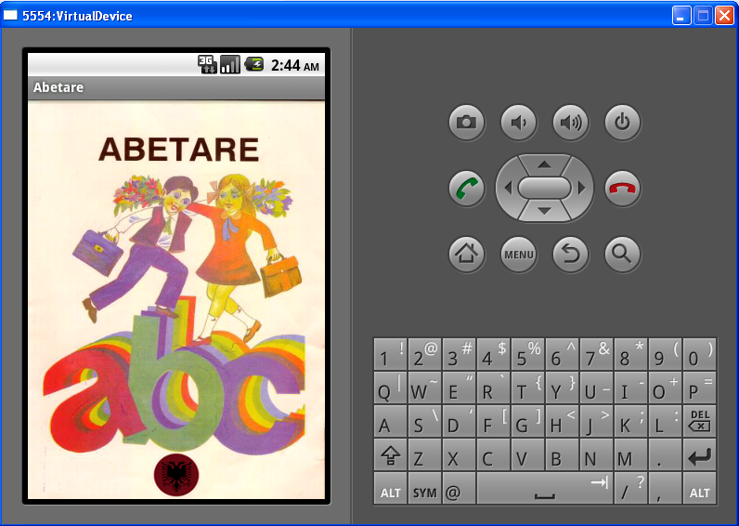
Turn to Abetare
ABC-book

Slide 15
Abetare application classes
Source code contains 37 classes 37 activities: Abetare.java + 36 classes (aaa.java … zhzh.java)
All files in “java” have their corresponding “xml” file.
Initialization of the activities and the communication with layout -- “abetare.xml”.
Communication between 36 activities (classes) -- intent.
Application
Code in java
(Abetare.java, Aaa.java,Bbb.java,…)
Code in XML
(abetare.xml.aaa.xml,bbb.xml,…)

Slide 16

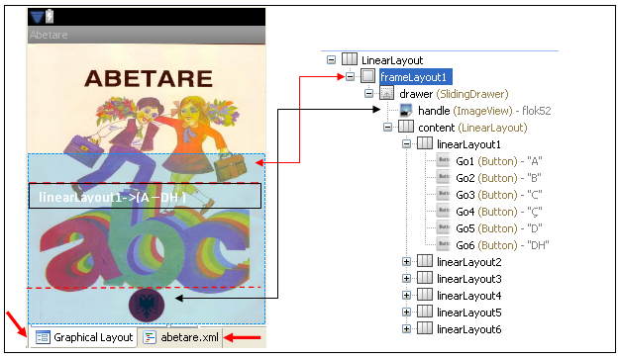
First page of application
All of these are done using XML

Slide 17
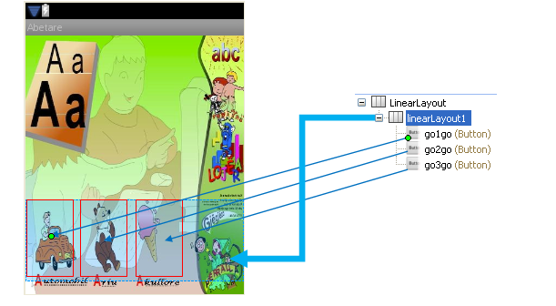
Second page of applcation
(Letter : “A”)
go1go– listen the word of 1st picture

Slide 18
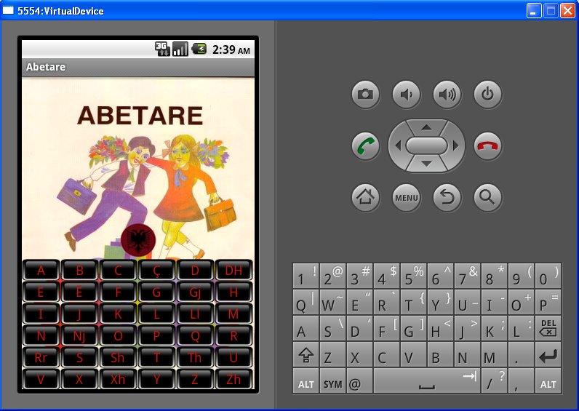
Testing 0f the application
Click over the Albanian flag icon to open the
Albanian letters

Slide 19
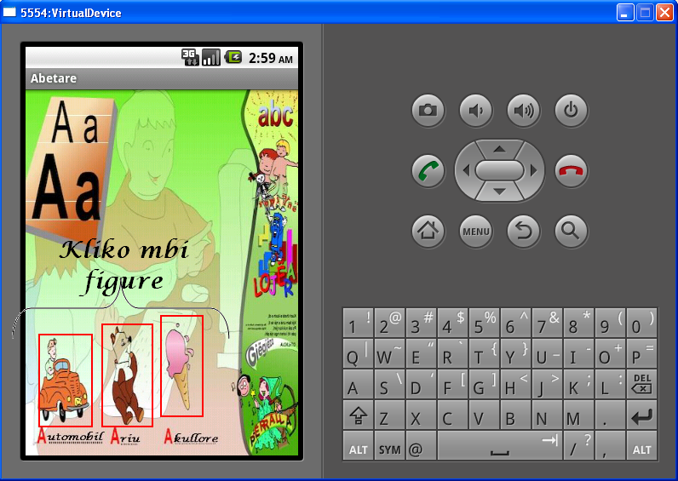
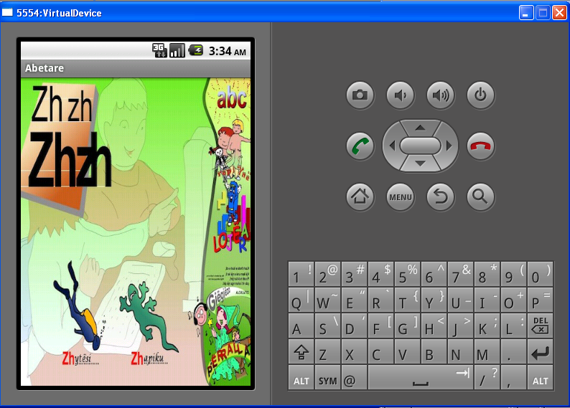
Testimi për shkronjën “A” dhe “ZH”
When we
click over a
letter, we go
to a property
new page
from A to ZH.
When we click
over a picture of
each page, listen
the name of
picture written
below.

Slide 20
Conclusions:
Over Android platform we can build too many application that provide a lot of services to a user.
Co-operation of different programing language make the programmer and designer work easier. So it was a good idea for java-XML combination.
And a very important conclusion is that without SE (Prof Klaus and Zoran) and Java PL (Prof Elinda Kajo) it might be a lot difficult for me ☺, Thank you a lot!

Slide 21

From ABETARE ☺
«Faleminderit»
That means:
Thank you!!!
Questions?
…….
www.google.com

